Slide 1
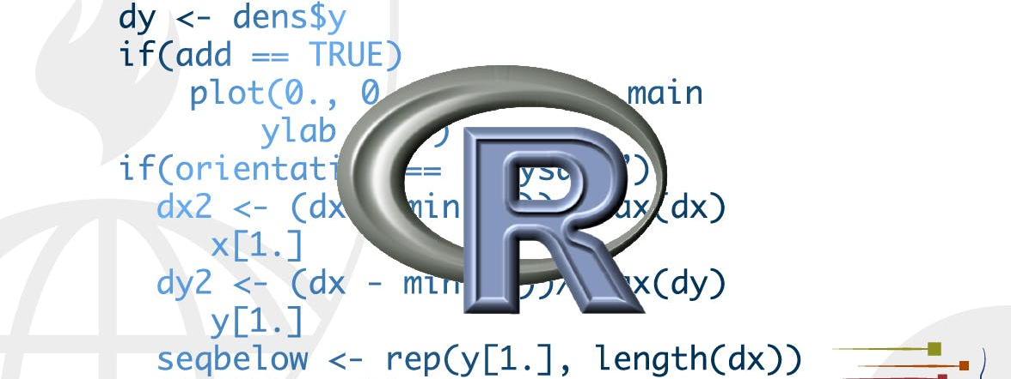
Data wrangling
STA 4233 Introduction to Programming and Data Management in R
Notes:
In this part of the book, you’ll learn about data wrangling, the art of getting your data into R in a useful form for visualisation and modelling. Data wrangling is very important: without it you can’t work with your own data!

Slide 2
INtroduction
Visualize
Import
Tidy
Transform
Communicate
Wrangle
Model
Understand
Program
Notes:
There are three main parts to data wrangling:
This part of the course proceeds as follows:
In tibbles, you’ll learn about the variant of the data frame that we use in this course: the tibble. You’ll learn what makes them different from regular data frames, and how you can construct them “by hand”.
In data import, you’ll learn how to get your data from disk and into R. We’ll focus on plain-text rectangular formats, but will give you pointers to packages that help with other types of data.
In tidy data, you’ll learn about tidy data, a consistent way of storing your data that makes transformation, visualization, and modelling easier. You’ll learn the underlying principles, and how to get your data into a tidy form.

Slide 3
Data wrangling
Relational data will give you tools for working with multiple interrelated datasets.
Strings will introduce regular expressions, a powerful tool for manipulating strings.
Factors are how R stores categorical data. They are used when a variable has a fixed set of possible values, or when you want to use a non-alphabetical ordering of a string.
Dates and times will give you the key tools for working with dates and date-times.
Notes:
Data wrangling also encompasses data transformation, which you’ve already learned a little about. Now we’ll focus on new skills for three specific types of data you will frequently encounter in practice:
Relational data will give you tools for working with multiple interrelated datasets.
Strings will introduce regular expressions, a powerful tool for manipulating strings.
Factors are how R stores categorical data. They are used when a variable has a fixed set of possible values, or when you want to use a non-alphabetical ordering of a string.
Dates and times will give you the key tools for working with dates and date-times.
STOP

Slide 4

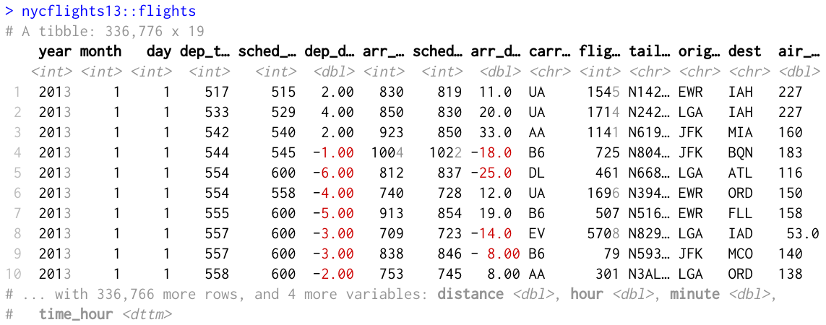
Tibbles
Notes:
Throughout this course we work with “tibbles” instead of R’s traditional data.frame. Tibbles are data frames, but they tweak some older behaviours to make life a little easier. R is an old language, and some things that were useful 10 or 20 years ago now get in your way. It’s difficult to change base R without breaking existing code, so most innovation occurs in packages. Here we will describe the tibble package, which provides opinionated data frames that make working in the tidyverse a little easier. In most places, I’ll use the term tibble and data frame interchangeably; when I want to draw particular attention to R’s built-in data frame, I’ll call them data.frames.
If this chapter leaves you wanting to learn more about tibbles, you might enjoy vignette("tibble").

Slide 5
Creating tibbles
as_tibble(iris)
#> # A tibble: 150 x 5
#> Sepal.Length Sepal.Width Petal.Length Petal.Width Species
#> <dbl> <dbl> <dbl> <dbl> <fct>
#> 1 5.1 3.5 1.4 0.2 setosa
#> 2 4.9 3 1.4 0.2 setosa
#> 3 4.7 3.2 1.3 0.2 setosa
#> 4 4.6 3.1 1.5 0.2 setosa
#> 5 5 3.6 1.4 0.2 setosa
#> 6 5.4 3.9 1.7 0.4 setosa
#> # … with 144 more rows
Notes:
Almost all of the functions that you’ll use in this course produce tibbles, as tibbles are one of the unifying features of the tidyverse. Most other R packages use regular data frames, so you might want to coerce a data frame to a tibble. You can do that with as_tibble():

Slide 6
tibble
tibble(
x = 1:5,
y = 1,
z = x ^ 2 + y
)
#> # A tibble: 5 x 3
#> x y z
#> <int> <dbl> <dbl>
#> 1 1 1 2
#> 2 2 1 5
#> 3 3 1 10
#> 4 4 1 17
#> 5 5 1 26
Notes:
You can create a new tibble from individual vectors with tibble(). tibble() will automatically recycle inputs of length 1, and allows you to refer to variables that you just created, as shown.
If you’re already familiar with data.frame(), note that tibble() does much less: it never changes the type of the inputs (e.g. it never converts strings to factors!), it never changes the names of variables, and it never creates row names.

Slide 7
non-syntactic names
tb <- tibble(
`:)` = "smile",
` ` = "space",
`2000` = "number"
)
tb
#> # A tibble: 1 x 3
#> `:)` ` ` `2000`
#> <chr> <chr> <chr>
#> 1 smile space number
Notes:
It’s possible for a tibble to have column names that are not valid R variable names, aka non-syntactic names. For example, they might not start with a letter, or they might contain unusual characters like a space. To refer to these variables, you need to surround them with backticks, `
You’ll also need the backticks when working with these variables in other packages, like ggplot2, dplyr, and tidyr.

Slide 8
tribble
tribble(
~x, ~y, ~z,
#--|--|----
"a", 2, 3.6,
"b", 1, 8.5
)
#> # A tibble: 2 x 3
#> x y z
#> <chr> <dbl> <dbl>
#> 1 a 2 3.6
#> 2 b 1 8.5
Notes:
Another way to create a tibble is with tribble(), short for transposed tibble. tribble() is customised for data entry in code: column headings are defined by formulas (i.e. they start with ~), and entries are separated by commas. This makes it possible to lay out small amounts of data in easy to read form.
I often add a comment (the line starting with #), to make it really clear where the header is.
STOP

Slide 9


Tibbles vs. data.frame
Notes:
There are two main differences in the usage of a tibble vs. a classic data.frame: printing and subsetting.

Slide 10
Printing
tibble(
a = lubridate::now() + runif(1e3) * 86400,
b = lubridate::today() + runif(1e3) * 30,
c = 1:1e3,
d = runif(1e3),
e = sample(letters, 1e3, replace = TRUE)
)
#> # A tibble: 1,000 x 5
#> a b c d e
#> <dttm> <date> <int> <dbl> <chr>
#> 1 2020-01-15 20:43:23 2020-01-22 1 0.368 n
#> 2 2020-01-16 14:48:32 2020-01-27 2 0.612 l
#> 3 2020-01-16 09:12:12 2020-02-06 3 0.415 p
#> 4 2020-01-15 22:33:29 2020-02-05 4 0.212 m
#> 5 2020-01-15 18:57:45 2020-02-02 5 0.733 i
#> 6 2020-01-16 05:58:42 2020-01-29 6 0.460 n
#> # … with 994 more rows
Notes:
Tibbles have a refined print method that shows only the first 10 rows, and all the columns that fit on screen. This makes it much easier to work with large data. In addition to its name, each column reports its type, a nice feature borrowed from str():
Tibbles are designed so that you don’t accidentally overwhelm your console when you print large data frames. But sometimes you need more output than the default display. There are a few options that can help.

Slide 11
Printing
You can explicitly print() the data frame, control the number of rows, and the width of the display
You can also control the default print behavior by setting options:
options(tibble.print_max = n, tibble.print_min = m): if more than n rows, print only m rows.
Use options(tibble.print_min = Inf) to show all rows.
Use options(tibble.width = Inf) to print all columns
You can see a complete list of options by looking at the package help with package?tibble.
nycflights13::flights %>%
print(n = 10, width = Inf)
Notes:
First, you can explicitly print() the data frame and control the number of rows (n) and the width of the display. width = Inf will display all columns:
You can also control the default print behaviour by setting options:
options(tibble.print_max = n, tibble.print_min = m): if more than n rows, print only m rows. Use options(tibble.print_min = Inf) to always show all rows.
Use options(tibble.width = Inf) to always print all columns, regardless of the width of the screen.
You can see a complete list of options by looking at the package help with package?tibble.

Slide 12
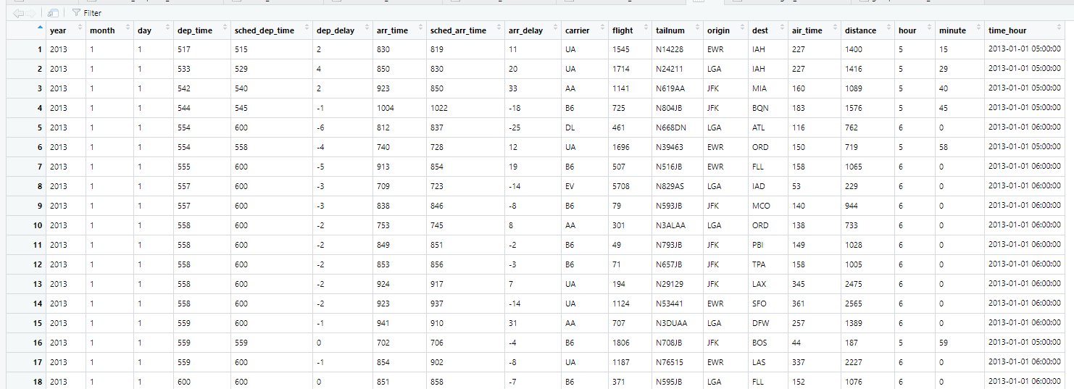
Printing
nycflights13::flights %>%
View()
Notes:
A final option is to use RStudio’s built-in data viewer to get a scrollable view of the complete dataset. This is also often useful at the end of a long chain of manipulations.

Slide 13
Subsetting
df <- tibble(
x = runif(5),
y = rnorm(5)
)
# Extract by name
df$x
#> [1] 0.7330 0.2344 0.6604 0.0329 0.4605
df[["x"]]
#> [1] 0.7330 0.2344 0.6604 0.0329 0.4605
# Extract by position
df[[1]]
#> [1] 0.7330 0.2344 0.6604 0.0329 0.4605
Notes:
So far all the tools you’ve learned have worked with complete data frames. If you want to pull out a single variable, you need some new tools, $ and [[. [[ can extract by name or position; $ only extracts by name but is a little less typing.

Slide 14
Subsetting
To use these in a pipe, you’ll need to use the special placeholder
.
df %>% .$x
#> [1] 0.7330 0.2344 0.6604 0.0329 0.4605
df %>% .[["x"]]
#> [1] 0.7330 0.2344 0.6604 0.0329 0.4605
Notes:
To use these in a pipe, you’ll need to use the special placeholder .
Compared to a data.frame, tibbles are more strict: they never do partial matching, and they will generate a warning if the column you are trying to access does not exist.
STOP

Slide 15
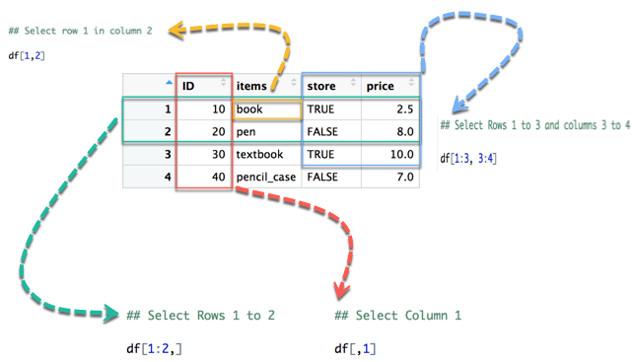
Interacting with older code
class(as.data.frame(tb))
#> [1] "data.frame"
dplyr::filter()
dplyr::select()
Notes:
Some older functions don’t work with tibbles. If you encounter one of these functions, use as.data.frame() to turn a tibble back to a data.frame:
The main reason that some older functions don’t work with tibble is the [ function. We don’t use [ much in this course because dplyr::filter() and dplyr::select() allow you to solve the same problems with clearer code (but you will learn a little about it in vector subsetting). With base R data frames, [ sometimes returns a data frame, and sometimes returns a vector. With tibbles, [ always returns another tibble.

Slide 16
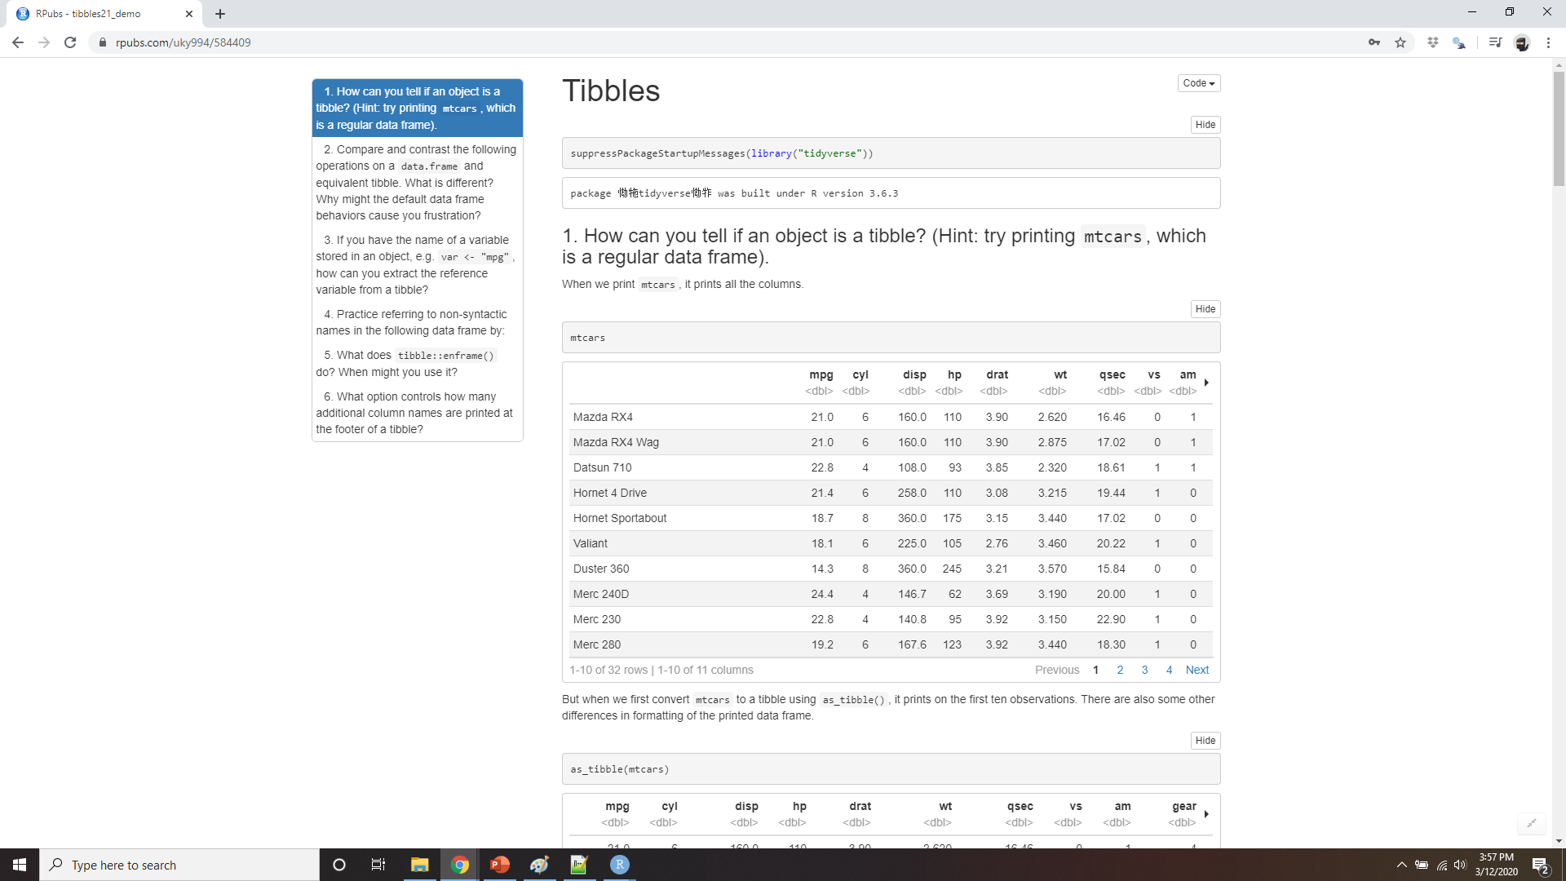
Demo tibbles
Notes:
https://rpubs.com/uky994/584409
How can you tell if an object is a tibble? (Hint: try printing mtcars, which is a regular data frame).
Compare and contrast the following operations on a data.frame and equivalent tibble. What is different? Why might the default data frame behaviours cause you frustration?
df <- data.frame(abc = 1, xyz = "a") df$x df[, "xyz"] df[, c("abc", "xyz")]
If you have the name of a variable stored in an object, e.g. var <- "mpg", how can you extract the reference variable from a tibble?
Practice referring to non-syntactic names in the following data frame by:
Extracting the variable called 1.
Plotting a scatterplot of 1 vs 2.
Creating a new column called 3 which is 2 divided by 1.
Renaming the columns to one, two and three.
annoying <- tibble( `1` = 1:10, `2` = `1` * 2 + rnorm(length(`1`)) )
What does tibble::enframe() do? When might you use it?
What option controls how many additional column names are printed at the footer of a tibble?

